Slide 1
Transition to Hybrid Learning Orientation
John Marshall School of Engineering
We will begin shortly.
Please mute your microphone.

Slide 2
Welcome Back!
This is an informative session to highlight safety protocols and procedures expected for hybrid learning.
Please mute your microphones.
The meeting is being recorded for families who cannot attend, and a copy of this recording will be placed on our website.
If you have questions during the presentation, please place them in the chat.
We will have a question/answer session at the end of the presentation.
If you are calling in, please email timothy.primus@clevelandmetroschools.org, and we will respond within 48 hours.

Slide 3
Our Priorities
Maintaining the health, safety, and well-being of our scholars and staff
Exemplify excellence in learning and teaching, filled with joy and aligned to a coherent, unified core curriculum
Supporting our scholars, staff, and families as they adapt to new methods and rhythms of learning and teaching
Ensuring operational efficiency across the organization to encourage flexibility and financial health
Partnering with community organizations and leveraging local assets to more fully and equitably support our scholars and their families
To view more details about the health and safety protocols in place at every school visit our website at:
https://www.clevelandmetroschools.org/Hybrid
and well-being of our s
Notes:
Website will have updates to Guidebook, schedules, other important information. Page update notifications will posted.

Slide 4
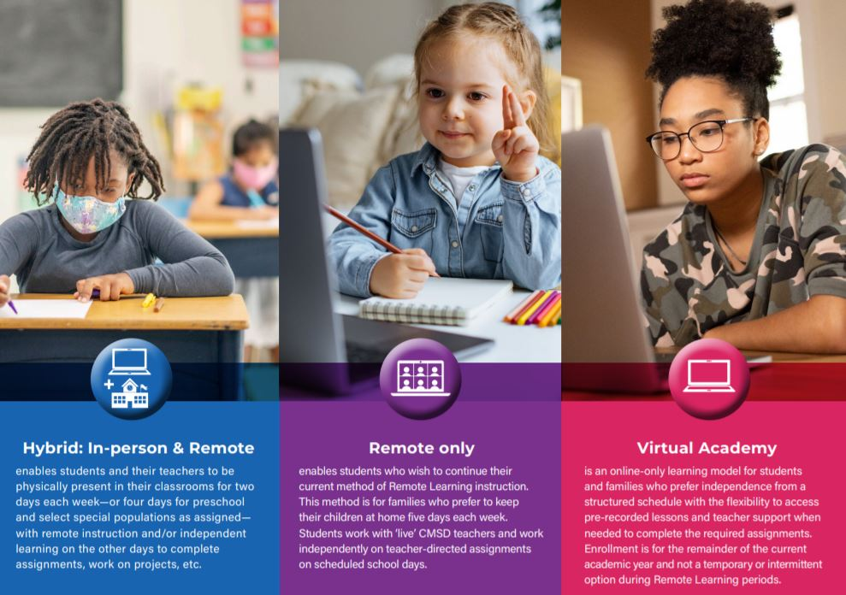
Notes:
Learning options for scholars and families. Visit webpage for more information on these models. https://www.clevelandmetroschools.org/Page/18504

Slide 5
OPT out Information
Families who want to remain in Remote Learning can do so by calling 216.838.3675 to speak with an enrollment specialist. Deadline to OPT out is March 19th.
You may also use the link on the district’s hybrid page.
https://app.smartsheet.com/b/form/19ee16ad3d12405dbb17fee28549f341
Notes:
Need to let parents know at what point (date) decision is binding.

Slide 6
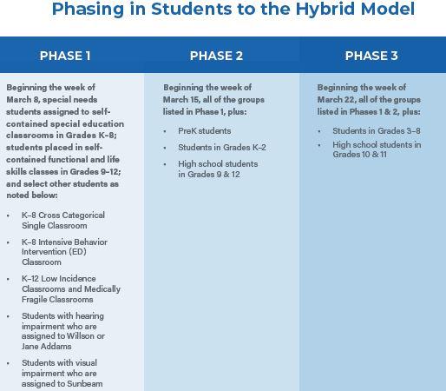

Slide 7
Important Contacts
Timothy Primus, Principal
Timothy.Primus@clevelandmetroschools.org
216-838-6104
Jason Clotman, Assistant Principal
Jason.Clotman@clevelandmetroschools.org
216-383-6106
Crystal Turnbo, Coordinator of Community & Business Leadership
Crystal.Turnbo@clevelandmetroschools.org
216-838-6115
Nichole McCroskey, Guidance Counselor
Nichole.Mccroskey@clevelandmetroschools.org
216-838-6107
Samira Farraj, School Secretary
Samira.Farraj@clevelandmetroschools.org
216-838-6100

Slide 8
Other Important Numbers

Slide 9
Update Your Contact Information
With students returning to the building, it is IMPORTANT that we have accurate contact information!
Please update your contact information if it has changed or we do not have the correct number or email address.
We need to be able to communicate with you!

Slide 10
School Hours and Visitation Procedures
School hours: 8:00 am – 3:00 pm
Please call to make an appointment prior to visit.
Visitors will complete COVID-19 health screening and have their temperature checked prior to entering the building. Visitors should social distance (6 feet).
All visitors must wear a face mask. If you don’t have a mask, one will be provided.

Slide 11
For the Safety of Everyone
Parents/Guardians/Visitors/Volunteers are NOT allowed inside the building or classrooms during the school day, except for a scheduled appointment or meal pick up.
The goal is to keep everyone safe. We need everyone, staff, students, and families to work together to help keep the school safe.

Slide 12
Arrival and Dismissal
Students may arrive at 7:30 am for breakfast. Dismissal will start at 2:45 pm for the building.
ARRIVAL:
Students will enter the building at the main doors off Viola Dr. near the flagpole
Students can arrive beginning at 7:45 am
Students will use the touchless thermometer system to check their temperatures.
Students will proceed to their 1st period class for breakfast.
DISMISSAL:
Students will not be permitted to wait in the building for rides or transportation.
Athletes must report directly to practice or will be removed from the building
Notes:
Put arrival routine, safety protocols, temperature checks, etc.

Slide 13
Getting Ready for School
Parents/caregivers will check their student’s health at home each morning
Students should stay home if they have any of these symptoms:
Fever of 100.4°
Cough
Headache
New loss of taste or smell
Sore throat
Congestion or runny nose
Fatigue
Nausea or vomiting
Diarrhea
Muscle or body aches

Slide 14
Getting Ready for School
Students will wear their clean cloth face covering to school and wear it throughout the day. We will provide cloth facemasks for all students and face shields for prek, kindergarten and some special population students.
Additional facemasks will be provided for students who need them.
Students (grades 1st – 12th) will be provided a computer backpack and should bring their fully charged device every day.
Uniforms are NOT required; however, students must wear school appropriate clothing.

Slide 15
Hybrid Learning Schedules
Students will be in school two or four days per week depending on their assignment
Most students will attend school two days per week
Only Preschool and special populations of students will attend four days per week
Students will be in Remote Learning or independent study on the other days
Parents may request to change their child’s assigned days by calling the Office of School Choice and Enrollment at 216.838.3675

Slide 16
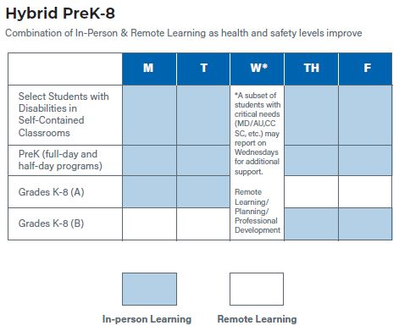
Sample Student Schedules

Slide 17
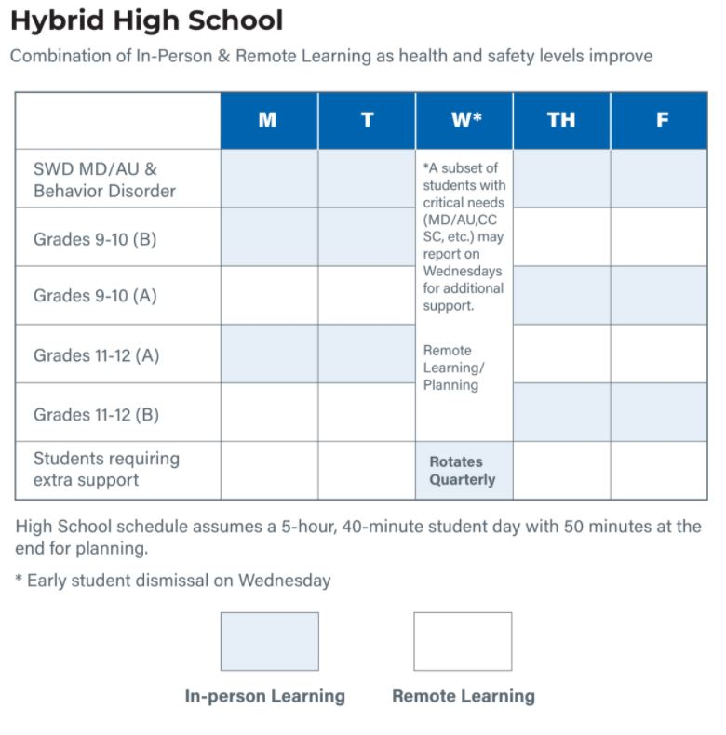
Sample Student Schedules

Slide 18
Health & Safety
CMSD continues to follow recommendations of medical and health experts
Temperature checkpoints and hand sanitizing stations are in place at all school buildings
Social distancing, defined as 6 feet between people, will be maintained at all times
Capacity on buses and in classrooms is limited to ensure fewer students are using the space at the same time
Classrooms, other areas of the school and buses will be cleaned and sanitized regularly between use

Slide 19
What Students Can Expect
High-quality instruction aligned to content, curriculum and method of delivery
One-to-one technology
Prepackaged meals to reduce food service lines.
Eating breakfast and lunch in classrooms to avoid large gatherings in the cafeteria.
Monitoring by a school nurse or health aide when exhibiting symptoms until picked up from school.
Access to a designated Care Clinic while waiting to be picked up.
Students should stay home for a full 24 hours after the fever or symptoms subside.
Access to a COVID-19 Hotline for any questions or concerns, 216.838.WELL (9355).

Slide 20
What Families Can Expect
Social distancing when their child is on a school bus, in a classroom, during breakfast, lunch, recess and other times in school facilities
Altered school and bus schedules due to decreased capacity
Required face coverings for students and parents in accordance with state and local guidance
A limited number will be provided to each student
Parents/caregivers/visitors will be provided masks as needed

Slide 21
What Families Can Expect
Two-way communication (phone calls, text messages, virtual meetings, and email)
Newsletter, updates via website and social media
Virtual Family Engagement activities
Virtual SPO/PAC/PCO meetings
Virtual or Phone Parent/teacher conferences
Access to a COVID-19 Hotline for any questions or concerns, 216.838.WELL (9355)

Slide 22
School Supplies and Materials
The school will supply students with:
A backpack with a sleeve for their device
Three cloths masks
Bottled water
Students should bring daily:
Their district provided laptop (fully charged)
Writing utensils and notebooks
Headphones to be used with laptops

Slide 23
Supporting Your Scholar’s Hybrid Learning
Get back into the routine of going back to school in-person, i.e. making bed, grooming, dressing for school, etc.
School uniforms are NOT required, but scholars should wear school appropriate clothing during hybrid and remote learning.
Create a schedule with your child and make a commitment to stick with it.
Structure and routine can greatly help your child from falling behind with assignments.
Discuss your family’s schedule and identify the best times for learning and instruction, as well as family-oriented physical activity, such as walks outside.
Use a family calendar or other visuals to keep track of in-person and remote days, deadlines and assignments.

Slide 24
Supporting Your Scholar’s Social Emotional Wellness
Watch for behavior changes in your child (e.g., excessive crying or irritation, excessive worry or sadness, unhealthy eating or sleeping habits, difficulty concentrating), which may be signs of your child struggling with stress and anxiety.
Ask how your child is feeling and communicate that what they may be feeling is normal.
Identify opportunities for your child to be physically active during hybrid/virtual/at-home learning.
Reach out to school staff for support.

Slide 25
Meal Distribution
John Marshall is a high school distribution location.
Every Tuesday from 10:00 am to 2:30 pm at the
cafeteria food can be picked up that covers a week
worth of time.
All elementary schools distribute everyday except
Tuesdays.

Slide 26
Transportation
RTA passes will be distributed to students
weekly based on district data determining
students that qualify for transportation
(NOTE: Please update your address in our
system accordingly)

Slide 27
Supports and Resources at our School
Applewood – 216-696-5800
Murtis Taylor – 216-283-4400
Bellaire Puritas Development Corporation– 216-671-2710
School distress hotline (call or text) : (440) 373-7955

Slide 28
Questions and Answers
Please place your questions or comments in the chat.
If you are participating by phone, please email your questions or comments to timothy.primus@clevelandmetroschools.org.
Notes:
All final details are being determined, we will send out the information as soon as it is worked out.

Slide 29
Closing Comments

